Slide 1

Biological Age Estimation Research
Sherri Ricardes
Colorado State University Global
Course Code: MIS581
Dr. Steve Chung
May 11, 2025
Notes:
Hi, My name is Sherri Ricardes. Today I am presenting my capstone research focused on the estimation of biological age. The estimation of biological age reflects how old a person seems biologically based on biomarkers, compared to their actual chronological age. The goal was to explore which biomarkers and lifestyle factors most strongly influence biological aging and to evaluate whether linear regression models and machine learning models can improve the accuracy of biological age predictions.

Slide 2




Introduction
People are living longer, making healthy aging and quality of life more important than ever.
Biological age, based on cellular and molecular changes, may differ from chronological age.
Factors like inflammation, stress, and lifestyle can accelerate aging.
Biomarkers can help predict biological age and support targeted health strategies.
Machine learning enables early detection of aging risks and supports proactive care.
Notes:
As people live longer, it's becoming more important to understand how we age and what factors contribute to healthy aging. Biological age refers to how old our body seems based on cellular and molecular changes, which can be different from our actual age. Factors like chronic inflammation, stress, and lifestyle habits such as diet, sleep, and exercise can speed up the aging process. By looking at specific biomarkers, we can estimate a person's biological age and identify potential health risks earlier. This presentation explores how linear regression and machine learning can improve these predictions and help support more personalized and proactive approaches to health and aging.

Slide 3
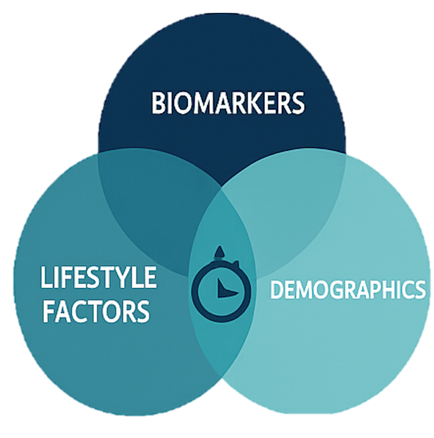
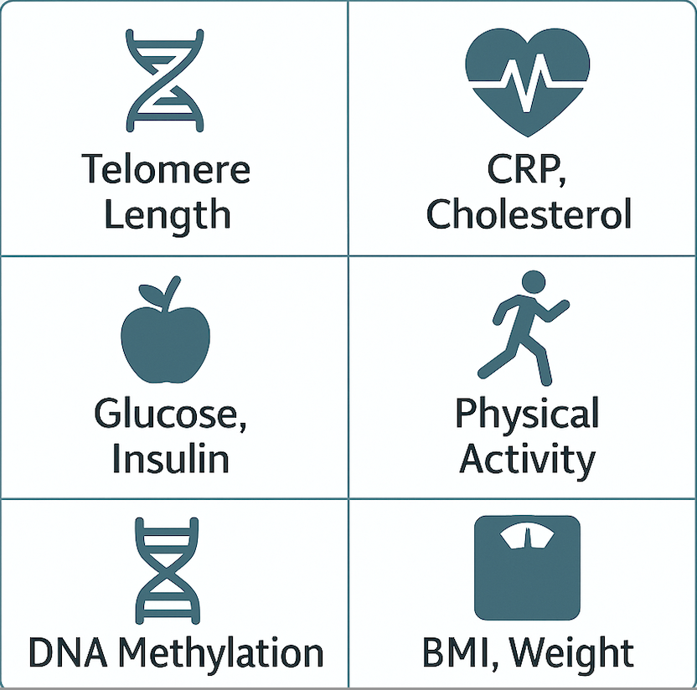
Objectives
Develop a predictive model of biological age using NHANES biomarker and lifestyle data.
Identify key predictors of accelerated aging, including age, telomere length, C-reactive protein (CRP), vitamin D, and self-reported health.
Compare the accuracy of linear regression and machine learning models (e.g., Random Forest, Bagged Trees).
Support future health strategies by highlighting modifiable aging factors (e.g., physical activity, inflammation).
Key Variables from NHANES
Notes:
The goal of this project was to build a predictive model of biological age using data from NHANES, which includes a wide range of biomarker and lifestyle variables. One objective was to identify which indicators are most strongly linked to accelerated aging, such as age, telomere length, CRP, vitamin D, and self-reported health. The study also compared the performance of different modeling approaches, specifically traditional linear regression versus machine learning models like Random Forest and Bagged Trees. Finally, the project aimed to support future health strategies by highlighting modifiable factors, such as physical activity and inflammation, that could slow biological aging.

Slide 4


Overview of Study
Data Source: NHANES 2001–2002, merged across multiple files using SEQN.
Sample: 1,309 U.S. adults with biomarker and lifestyle data.
Variables Included: Telomere length, CRP, glucose, insulin, LDL, triglycerides, vitamin D, BMI, weight, physical activity, general health, age, gender, and more.
Biological Age Proxy: GrimAge (a DNA methylation clock shown to correlate with morbidity and mortality risk).
Approach: Combined exploratory analysis, linear regression, and machine learning (Random Forest, Bagged Trees).
Notes:
This project used data from the 2001 to 2002 NHANES survey, which includes detailed health information from a nationally representative sample of U.S. adults. Multiple datasets were merged using participant IDs to create a complete file. The final sample included 1,309 adults with both biomarker and lifestyle data. Key variables included telomere length, CRP (an inflammation marker), glucose, insulin, LDL, triglycerides, vitamin D, BMI, physical activity, general health, age, and gender. GrimAge, a DNA methylation-based clock, served as the biological age estimate because of its strong connection to aging-related health risks. The analysis combined exploratory data review, linear regression, and machine learning models, such as Random Forest and Bagged Trees, to compare performance in predicting biological age.

Slide 5

Research Questions and Hypotheses
RQ1: Can specific biomarkers (e.g., telomere length, DNA methylation, cholesterol, glucose, insulin) be used to estimate biological age?
H₀: No linear relationship between selected biomarkers and biological age
H₁: A linear relationship exists between selected biomarkers and biological age
RQ2: Do lifestyle factors (e.g., physical activity, fitness level) add predictive value beyond biomarkers?
H₀: Lifestyle factors do not add predictive value beyond biomarkers
H₁: Lifestyle factors do add predictive value beyond biomarkers
RQ3: Is the mean difference between biological age and chronological age significantly greater in individuals with poor health indicators (e.g., high inflammation, poor glucose/insulin control)?
H₀: There is no difference in the mean age (biological age minus chronological age) between individuals with poor health indicators
H₁: There is a difference in the mean age (biological age minus chronological age) between individuals with poor health indicators
Hypotheses tested using linear regression and machine learning models (e.g., Random Forest, Bagged Trees)
GrimAge used as the primary proxy for biological age
Notes:
This study focused on three main research questions.
The first asked whether specific biomarkers, like telomere length, DNA methylation, cholesterol, glucose, and insulin, could be used to estimate biological age. The hypothesis tested whether there was a linear relationship between these biomarkers and biological age.
The second question explored whether lifestyle factors, such as physical activity and fitness, added predictive value beyond what biomarkers alone could explain.
The third question looked at whether the mean difference between biological age and chronological age was greater in individuals with poor health indicators, like high inflammation or poor glucose and insulin control.
To test these hypotheses, both linear regression and machine learning models, such as Random Forest and Bagged Trees, were used. GrimAge, a DNA methylation-based biomarker, was used as the main proxy for biological age throughout the study.

Slide 6

Literature Review Highlights
Biological age offers a more accurate measure than chronological age by reflecting cellular and molecular aging.
Telomere length and DNA methylation clocks are validated biomarkers; combining them improves prediction accuracy.
Models using routine health data and machine learning (e.g., Bagged Trees) outperform traditional approaches.
Combining inflammation, metabolic, and immune function data improves biological age estimates.
Studies emphasize early detection and personalized healthcare by leveraging diverse data and analytical models.
Notes:
The literature shows that biological age provides a more accurate picture of how a person is aging compared to chronological age, because it reflects actual cellular and molecular changes. Telomere length and DNA methylation clocks are two well-established biomarkers, and studies show that combining them leads to better predictions. Researchers have also found that models using standard health data, along with machine learning techniques like Bagged Trees and Rational Quadratic, perform better than traditional methods. When multiple systems are analyzed together, such as inflammation, metabolic health, and immune function, the estimates of biological age become even more reliable. Finally, many studies highlight the potential of using these tools for early detection and to personalize healthcare by tailoring strategies to the individual based on their biological aging patterns.

Slide 7

Research Design
Methodology
Quantitative research using NHANES 2001–2002 dataset.
Dataset variables: Telomere length, DNA Methylation, age, CRP, glucose, insulin, cholesterol, BMI, weight, vitamin D, physical activity, general health, and demographics.
Biological age estimated using a DNA methylation clock (GrimAge).
Analytical approach: Multiple linear regression for interpretability and baseline comparison.
Machine learning models (Random Forest, Bagged Trees, SVM) tested for improved accuracy.
Model performance assessed using R², RMSE, and MAE.
Notes:
This project followed a quantitative research design using data from the 2001–2002 NHANES survey. The dataset includes a wide range of health and demographic information. Key variables in the analysis were telomere length, CRP, glucose, insulin, cholesterol, BMI, physical activity, general health, and demographic data.
Biological age was estimated using GrimAge, a DNA methylation clock that’s widely used in aging research. For the analysis, multiple linear regression was used first to provide a baseline and interpretability. Then, machine learning models, including Random Forest, Bagged Trees, and Support Vector Machine, were applied to test whether they could improve predictive performance.
To evaluate the models, performance metrics like R², RMSE, and MAE were used to compare accuracy across approaches.

Slide 8
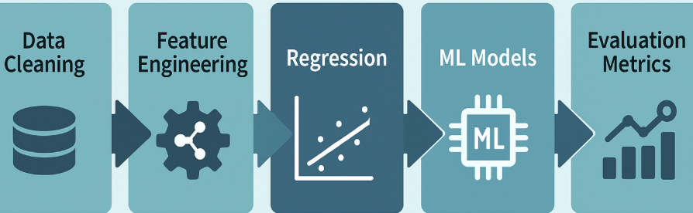
Missing values handled using mean imputation.
Normalization applied to continuous variables.
Categorical variables (e.g., gender, general health) dummy coded.
Feature selection used correlation and VIF to reduce multicollinearity.
Data not split into training/testing sets—focus on explanatory modeling.
Analysis conducted in Python using Statsmodels for regression.
Machine learning models (Random Forest, Bagged Trees, SVM) also applied.
Evaluation metrics: R², RMSE, MAE, feature importance.
Methods
Notes:
The analysis began by handling missing values using mean imputation. Continuous variables were normalized to ensure consistency across features, and categorical variables such as gender and general health were dummy coded.
To reduce multicollinearity, feature selection was guided by correlation analysis and variance inflation factor (VIF). Since the focus was on explanatory modeling rather than prediction, the data was not split into training and testing sets.
Regression analysis was conducted using the Statsmodels library in Python. In addition, machine learning models including Random Forest, Bagged Trees, and Support Vector Machine were applied to assess whether they offered improved accuracy.
Model performance was evaluated using R-squared, RMSE, MAE, and feature importance scores.

Slide 9


Limitations and Ethical Considerations
NHANES data is cross-sectional, limiting analysis of aging over time.
Missing biomarker data reduced usable sample size.
Self-reported measures (e.g., physical activity, health status) may be biased.
Statistical and ML models may not fully capture aging's biological complexity.
NHANES data is de-identified but still requires ethical handling.
Clear consent and transparency about data use are essential parts of ethical research.
Predictive models must be used responsibly to avoid harm or discrimination.
Avoid overstating accuracy of biological age estimates in sensitive contexts.
Notes:
There were several limitations in this study. First, NHANES is a cross-sectional dataset, which means it only provides a snapshot in time. That makes it difficult to analyze how aging progresses over the long term. Missing biomarker data also reduced the final sample size. In addition, some variables, like physical activity and general health, were self-reported, which introduces the potential for bias. Finally, while statistical and machine learning models are powerful, they may not fully capture the biological complexity of aging.
On the ethical side, although NHANES data is de-identified, it still needs to be handled responsibly. In any original research setting, informed consent and data transparency are critical. Predictive models should be used carefully to avoid causing harm or reinforcing discrimination, especially in healthcare or insurance settings. It's also important not to overstate the accuracy of biological age estimates, particularly when these tools are used to inform real-world decisions.

Slide 10
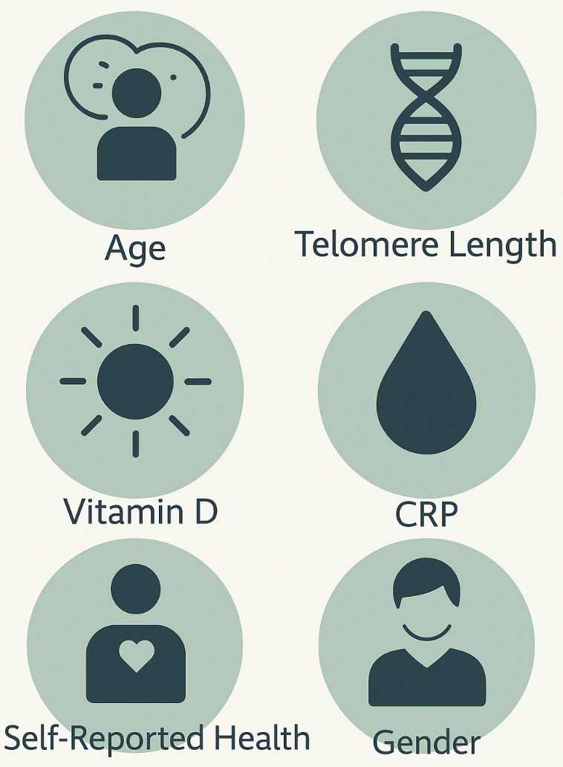
Findings
Biological age can be estimated using a combination of biomarkers, lifestyle factors, and demographics
Telomere length, CRP, vitamin D, gender, and self-rated health were significant predictors for linear regression
Linear regression provided baseline insights but explained less variance
Machine learning models (Random Forest, Bagged Trees) achieved higher accuracy and better performance
Random Forest identified age, BMI, weight, telomere length, and vitamin D as top predictors
Lifestyle and inflammation factors added value beyond traditional biomarkers
Results support integrating machine learning into biological aging research and health prediction
Notes:
These findings show that biological age can be estimated using a combination of biomarkers, lifestyle factors, and demographics. The most significant predictors were telomere length, CRP, vitamin D, age, gender, and self-reported health.
Linear regression provided some insights but explained less of the variation. In contrast, machine learning models, especially Random Forest and Bagged Trees, achieved higher accuracy. Random Forest identified age, BMI, weight, telomere length, and vitamin D as top predictors.
Adding lifestyle and inflammation-related variables improved the model’s performance beyond using biomarkers alone. Overall, the results support using machine learning to improve biological age prediction and inform more personalized health strategies.

Slide 11
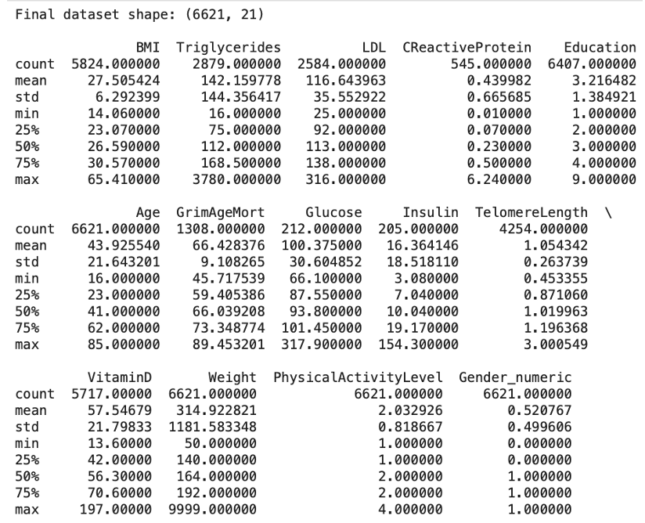
Descriptive Statistics
Figure 1
Summary Statistics of Numeric Variables in the Dataset.
Mean BMI: 27.5 | Mean Age: 43.9 | Mean GrimAge: 66.4
Large variability observed in triglycerides, BMI, and weight
Helped pinpoint which variables had missing values
Guided imputation and transformation strategies
Notes:
The dataset included 6,621 records, and the average values provide a general snapshot of the sample’s health. The mean BMI was 27.5, the mean chronological age was 43.9, and the mean GrimAge, which estimates biological age, was 66.4.
There was large variability in several biomarkers, especially triglycerides, BMI, and weight. This kind of spread matters because it can affect how models learn and predict.
The summary statistics also helped identify which variables had missing values. For example, CRP, glucose, and insulin had noticeably fewer data points compared to others.
Overall, these insights guided how missing values were handled and helped shape the transformation strategies used during preprocessing.

Slide 12
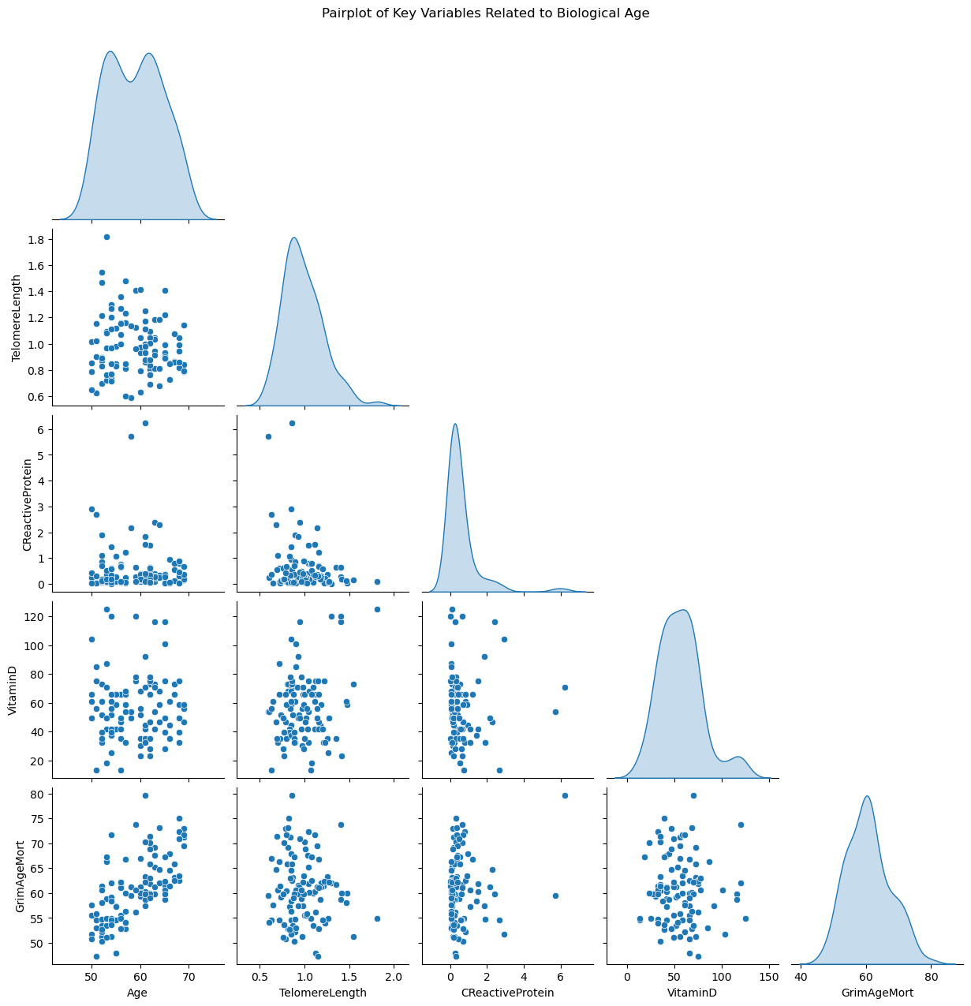
Figure 2
Pair plot of Key Variables Related to Biological Age.
Variable Relationships
GrimAge and chronological age show a positive linear relationship.
Other variables (telomere length, CRP, vitamin D) show weak or inconsistent patterns
Visual patterns helped guide variable selection for modeling
Notes:
Examining variable relationships helped identify which factors were most relevant to biological aging. GrimAge showed a positive linear relationship with chronological age, confirming that biological age generally increases as people get older.
Telomere length, CRP, and vitamin D showed weaker and more scattered patterns in relation to GrimAge and chronological age. While telomere length appeared to have a slight negative trend, and CRP a possible positive trend, neither showed a strong or consistent relationship. Vitamin D showed little to no visual correlation. These variables may still be meaningful when combined with others, but their individual predictive strength appears limited in the scatterplots.
These patterns helped determine the selection of variables for regression and machine learning models.
Distribution Insights:
Age and GrimAgeMort followed relatively normal distributions, though GrimAgeMort was more tightly centered.
Telomere length was slightly right-skewed, with a peak near 1.0.
CRP was highly right-skewed, indicating many low values and a few extreme outliers.
Vitamin D also displayed right skew, with most values clustered between 20 and 75.
Scatterplot Insights:
Age and GrimAgeMort showed a positive relationship.
Telomere length, CRP, and vitamin D showed weak or scattered trends with GrimAgeMort and age, making them less reliable as standalone predictors.
Variability in vitamin D appeared to increase with age, but no strong pattern emerged.
A slight inverse pattern was seen between CRP and telomere length, though it was not clearly defined.
Overall Insight:
GrimAgeMort closely aligned with chronological age, validating its role as a biological age proxy. While some variables showed potential relevance, such as telomere length and CRP, their individual relationships were weak. Distribution patterns also indicated the need for possible transformations, particularly for CRP, before modeling.

Slide 13
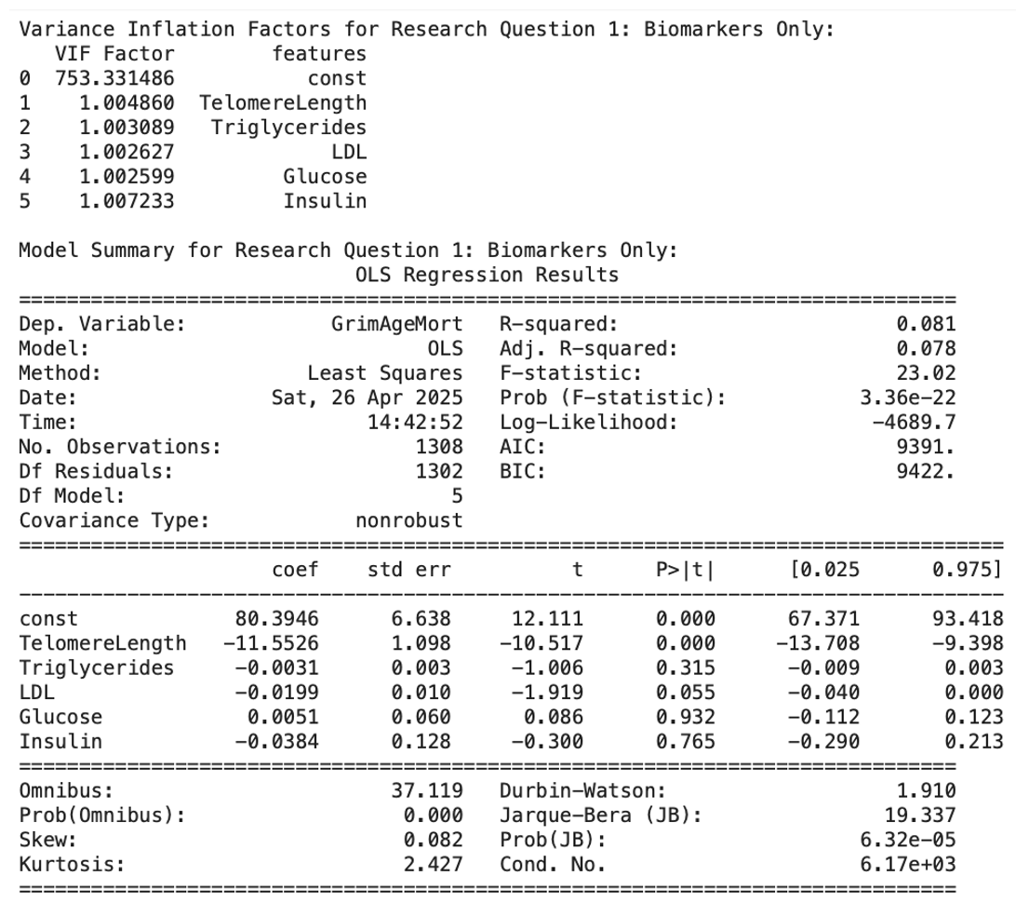
Multiple Linear Regression Results – Research Question 1
Can specific biomarkers (e.g., telomere length, cholesterol, glucose, insulin) estimate biological age?
A multiple linear regression was run using telomere length, triglycerides, LDL, glucose, and insulin.
The model was statistically significant: F(5, 1302) = 23.02, p < 0.001.
Adjusted R² = 0.078 (7.8%), indicating a weak explanatory power.
Telomere length was a significant predictor (p < 0.001); longer telomeres → lower GrimAge.
Triglycerides, LDL, glucose, and insulin were not significant (p > 0.05).
Conclusion: Reject the null hypothesis for telomere length; fail to reject for other biomarkers.
Figure 3
Regression results for Research Question 1: Biomarkers only.
Notes:
To test whether specific biomarkers could estimate biological age, a multiple linear regression was run using telomere length, triglycerides, LDL, glucose, and insulin.
The model was statistically significant, but the adjusted R² was only 0.078, meaning it explained just under 8% of the variance in GrimAge. This suggests that while the model has predictive value, it's relatively weak.
Among the biomarkers tested, only telomere length was a significant predictor. Longer telomeres were associated with lower GrimAge scores, aligning with existing research on cellular aging.
Triglycerides, LDL, glucose, and insulin were not statistically significant in this model, indicating limited predictive power for those markers on their own.
In conclusion, the null hypothesis was rejected for telomere length but not for the other biomarkers. This emphasizes the importance of telomere length in estimating biological age and suggests that additional variables may be needed for a stronger predictive model.

Slide 14
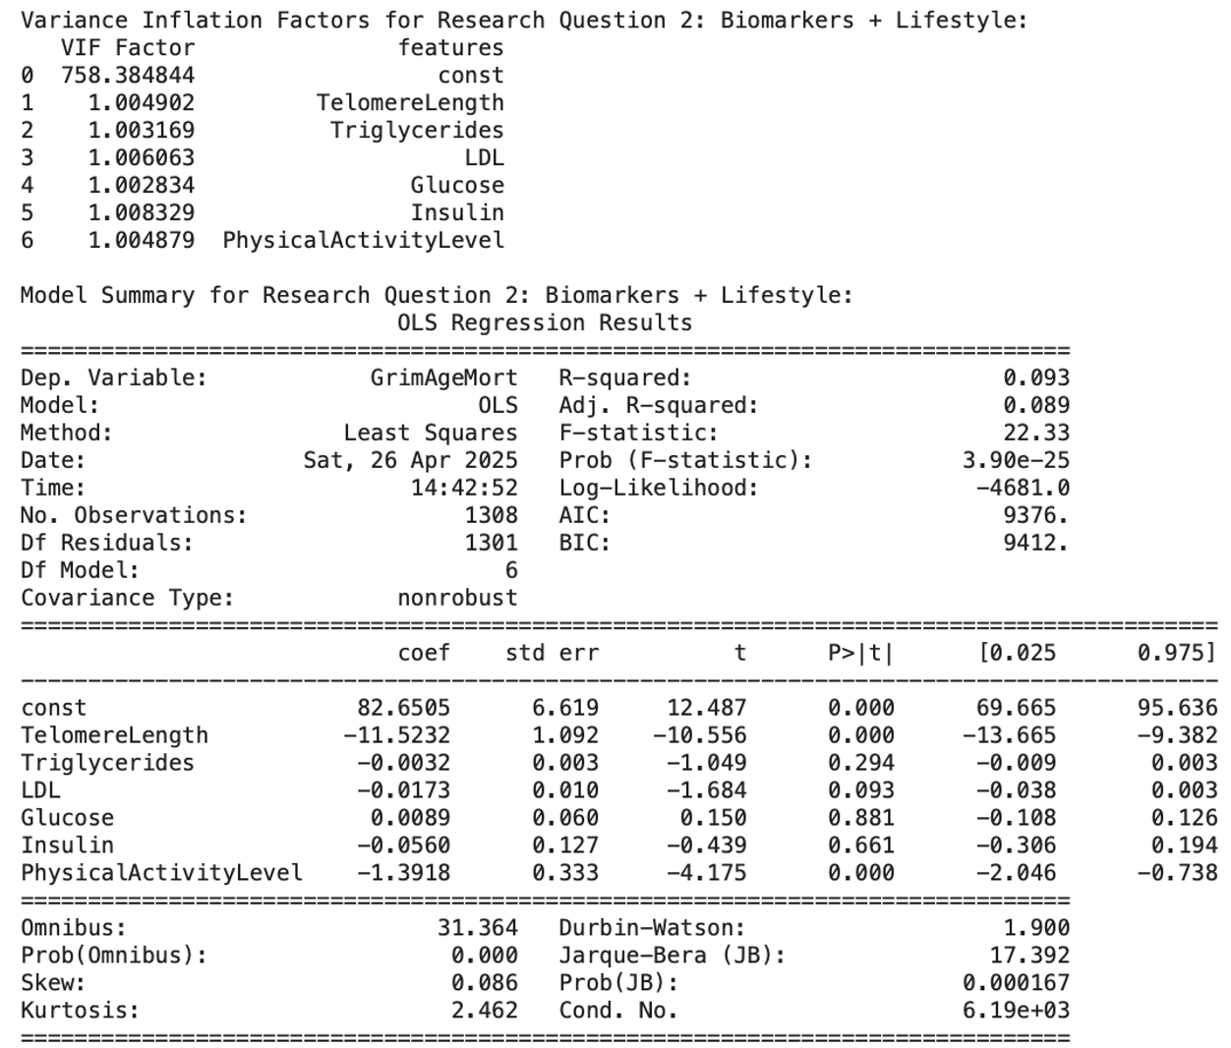
Multiple Linear Regression Results – Research Question 2
Do lifestyle factors, such as physical activity, add predictive value beyond biomarkers alone?
Added physical activity level to the biomarker-only regression model.
The model remained statistically significant, F(6, 1301) = 22.33, p < 0.001.
Adjusted R² increased slightly to 0.089 (8.9%), suggesting a small improvement in explanatory power.
Physical activity level was a significant predictor (p < 0.001).
Lower activity levels were associated with higher biological age (GrimAge).
Conclusion: Including physical activity, adds predictive value beyond biomarkers alone. The null hypothesis was rejected.
Figure 4
Regression results for Research Question 2: Biomarkers plus lifestyle factors.
Notes:
To address whether lifestyle factors improve prediction, physical activity level was added to the original biomarker-only regression model.
The updated model remained statistically significant, and the adjusted R² increased slightly from 0.078 to 0.089, which indicates a small improvement in explanatory power.
Therefore, physical activity was a significant predictor. Lower levels of physical activity were associated with higher biological age, reinforcing the link between lifestyle and aging.
Although the gain in explanatory power was modest, the results suggest that physical activity adds value beyond traditional biomarkers.
Based on this, the null hypothesis was rejected for physical activity, showing that lifestyle behaviors can contribute to biological age prediction.

Slide 15
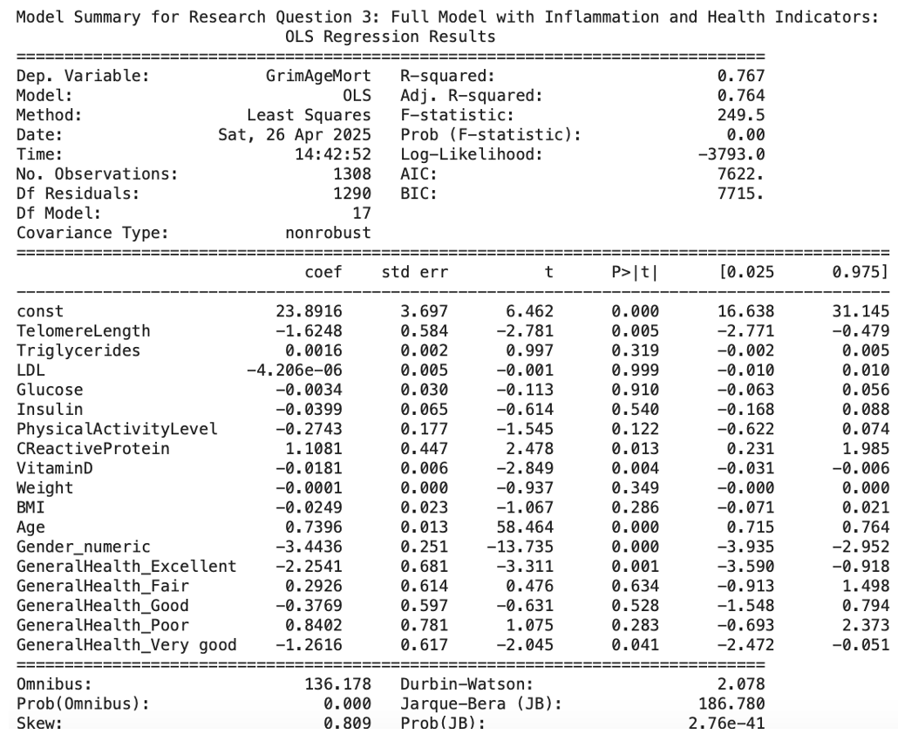
Multiple Linear Regression Results – Research Question 3
Is the mean difference between biological and chronological age greater among individuals with poor health indicators?
Model was statistically significant: F(17, 1290) = 249.5, p < 0.001
Adjusted R² = 0.764, explaining 76.7% of the variance in GrimAge
Significant predictors: age, telomere length, CRP, vitamin D, gender, self-reported health
Higher age, CRP, and male gender → higher GrimAge
Longer telomeres, more vitamin D, better self-rated health → lower GrimAge
Conclusion: null hypothesis rejected for CRP, vitamin D, and self-rated health.
Figure 5
Regression results for Research Question 3: Full model with biomarkers, lifestyle, and health indicators.
Notes:
This model explored whether individuals with poor health indicators tend to have a larger gap between their biological and chronological age.
The regression was statistically significant and explained a substantial portion of the variance in GrimAge, with an adjusted R² of 0.764.
Key predictors included chronological age, telomere length, CRP, vitamin D, gender, and self-reported health status. Higher biological age was associated with older age, higher CRP levels, and being male. In contrast, longer telomeres, higher vitamin D levels, and better self-rated health were linked to lower biological age.
Based on these results, the null hypothesis was rejected for CRP, vitamin D, and self-rated health, indicating that these variables significantly contribute to biological aging estimates.

Slide 16
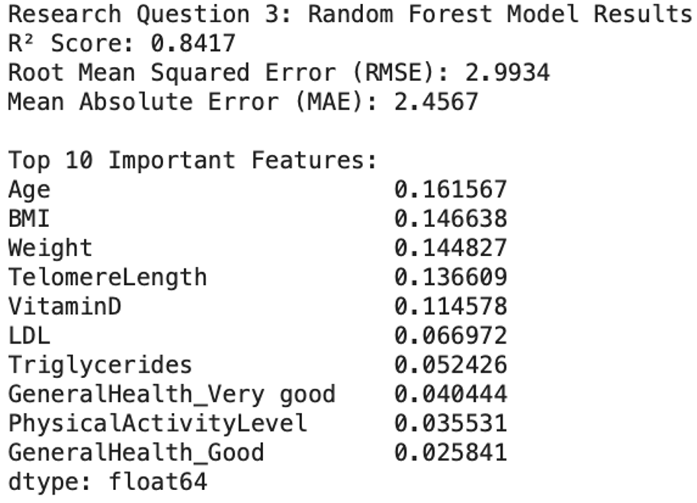
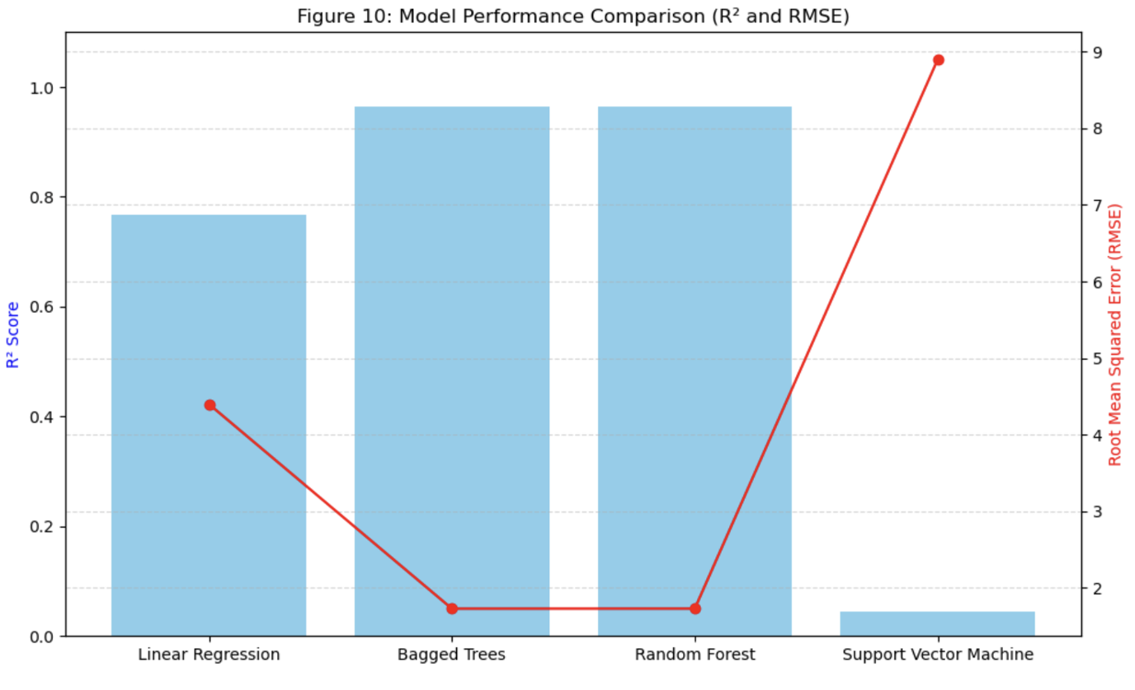
Linear Regression vs. Machine Learning Models
Traditional linear regression was used as a baseline model
Random Forest showed much higher predictive accuracy than linear regression with a R² of 84%
Non-linear models (Random Forest, Bagged Trees) outperformed linear and SVM models
Bagged Trees and Random Forest had the highest R² scores and lowest RMSE values
Machine learning outperforms linear regression in predicting biological age, especially when accounting for non-linear relationships.
Figure 6
Random Forest Model Results: R² Score, RMSE, MAE, and Top 10 Feature Importance.
Figure 7
Model performance comparison
Notes:
Linear regression served as the baseline model and gave us a basic understanding of variable relationships. However, it didn’t capture the complexity of the data very well.
When we introduced non-linear models like Random Forest and Bagged Trees, the predictive accuracy improved significantly. These models delivered higher R² scores and lower RMSE values than linear regression and the Support Vector Machine.
Random Forest in particular identified age, BMI, weight, telomere length, and vitamin D as the most important predictors.
Overall, the results show that machine learning models are more effective for estimating biological age, especially when dealing with non-linear relationships between variables.

Slide 17
Biological age can be predicted using a combination of biomarkers, lifestyle factors, and demographic data
Telomere length, CRP, vitamin D, gender, weight, BMI, and self-rated health are key predictors of biological age
Machine learning models (Random Forest, Bagged Trees) outperformed traditional linear regression in accuracy
Modifiable factors like inflammation and physical activity influence how fast we age biologically
Findings support the potential for personalized, data-driven strategies to promote healthy aging
Conclusion
Notes:
Biological age isn’t just about how many years we’ve lived. It reflects how our bodies are aging based on biomarkers, lifestyle, and health factors. In this study, telomere length, CRP, vitamin D, gender, BMI, weight, and self-rated health emerged as key predictors of biological age.
While linear regression offered a baseline, machine learning models like Random Forest and Bagged Trees delivered stronger predictive accuracy by capturing more complex patterns.
We also saw that modifiable factors like inflammation and physical activity had an impact on biological age, suggesting that how we live really can affect how we age.
These results open the door for personalized, data-driven approaches to support healthier aging and early intervention.

Slide 18
Recommendations
Use more advanced models: Explore neural networks and gradient boosting to improve prediction accuracy.
1
Track aging over time: Use longitudinal datasets to study changes in biomarkers and behaviors.
2
Add more biomarkers: Include markers of cell stress, energy production, and DNA repair for a fuller picture.
3
Incorporate lifestyle and psychosocial data: Add variables like diet, sleep, stress, and socioeconomic status.
4
Develop practical tools: Create easy-to-use biological age assessments for clinical or personal use.
5
Support public health efforts: Encourage healthy behaviors that slow biological aging, like exercise and anti-inflammatory diets.
6
Notes:
These recommendations are based on the findings from the study and aim to guide future research and practical applications. First, more advanced models like neural networks and gradient boosting should be explored to improve prediction accuracy beyond what linear regression and tree-based models can offer.
Second, instead of relying on cross-sectional data, future research should track individuals over time to better understand how biological aging unfolds. Longitudinal studies would help identify which changes are early warning signs of accelerated aging.
Third, expanding the range of biomarkers can give us a fuller picture. This could include markers of oxidative stress, energy metabolism, or DNA repair mechanisms.
Fourth, adding lifestyle and psychosocial variables like sleep, diet, and stress levels could help explain differences in aging that biomarkers alone can’t capture.
Fifth, there’s a real opportunity to turn biological age models into practical tools that people can use to monitor their health and make informed decisions.
Finally, we should support public health strategies that encourage behaviors known to slow aging—like physical activity, balanced nutrition, and reducing chronic inflammation.

Slide 19

References
Berghoff, M. (n.d.). How can you measure biological age? Retrieved March 22, 2025, from https://www.age.mpg.de/211116/ how-
can-you-measure-biological-age
Biomarkers of Aging Consortium, Herzog, C. M. S., Goeminne, L. J. E., et al. (2024). Challenges and recommendations for the
translation of biomarkers of aging. Nature Aging, 4(7), 1372–1383. https://doi.org/10.1038/s43587-024-00683-3
Bortz, J., Guariglia, A., Klaric, L., & et al. (2023). Biological age estimation using circulating blood biomarkers. Communications
Biology, 6, 1089. https://doi.org/10.1038/s42003-023-05456-z
Cui, H., Kong, Y., & Zhang, H. (2012). Oxidative stress, mitochondrial dysfunction, and aging. Journal of signal transduction, 2012,
646354. https://doi.org/10.1155/2012/646354
Erema, V. V., Chervova, N. S., & Osipyants, A. I. (2022). Biological age predictors: The status quo and future trends. International
Journal of Molecular Sciences, 23(23), 15103. https://doi.org/10.3390/ijms232315103
Floridi, L., & Taddeo, M. (2016). What is data ethics? Philosophical Transactions of the Royal Society A: Mathematical, Physical and
Engineering Sciences, 374(2083), 20160360. https://doi.org/10.1098/rsta.2016.0360
Jia, L., Zhang, W., & Chen, X. (2017). Common methods of biological age estimation. Clinical Interventions in Aging, 12, 759–
772. https://doi.org/10.2147/CIA.S134921
Jylhävä, J., Pedersen, N. L., & Hägg, S. (2017). Biological Age Predictors. EBioMedicine, 21, 29–36.
https://doi.org/10.1016/j.ebiom.2017.03.046
National Health and Nutrition Examination Survey (NHANES) 2001-2002. Centers for Disease Control and Prevention. Retrieved
March 29, 2025, from https://wwwn.cdc.gov/nchs/nhanes/continuousnhanes/default.aspx?BeginYear=2001
Ni, X., Zhao, H., Li, R., Su, H., Jiao, J., Yang, Z., Lv, Y., Pang, G., Sun, M., Hu, C., & Yuan, H. (2023). Development of a model for
the prediction of biological age. Computer Methods and Programs in Biomedicine, 240, 107686. https://doi.org/10.1016/j.cmpb.2023.107686
Polonsky, M. J., & Waller, D. S. (2019). Designing and managing a research project: A business student's guide (4th ed.). SAGE
Publications. ISBN: 9781544316468
Vaiserman, A., & Krasnienkov, D. (2021). Telomere Length as a Marker of Biological Age: State-of-the-Art, Open Issues, and Future
Perspectives. Frontiers in Genetics. https://www.frontiersin.org/articles/10.3389/fgene.2020.630186/full

